Slide 1

Data Visualization With
Presented by the Undergraduate Researchers Interested in Data

Slide 2
The Importance Of A Good Visualization
Why is it important
Describes the data in the most efficient manner
Compliments your storytelling
Discover underlying information
How to make a good visual
Ink-to-Data Ratio
Understanding Your Data (Dimensions and Measures)
To be able to communicate a clear story using your data

Slide 3
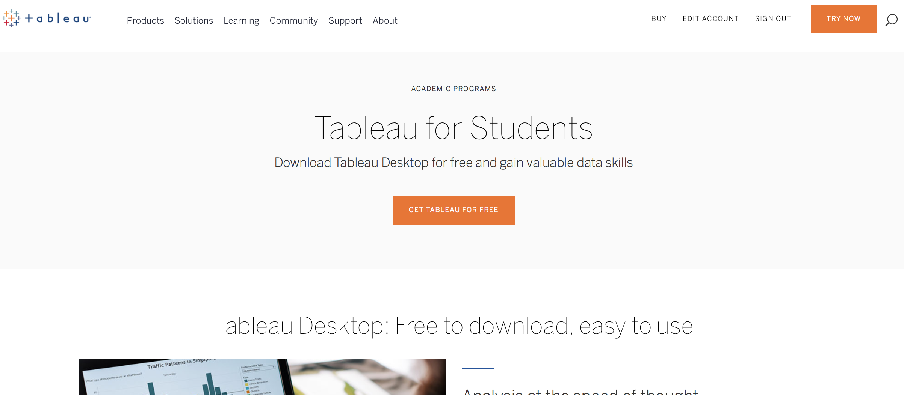
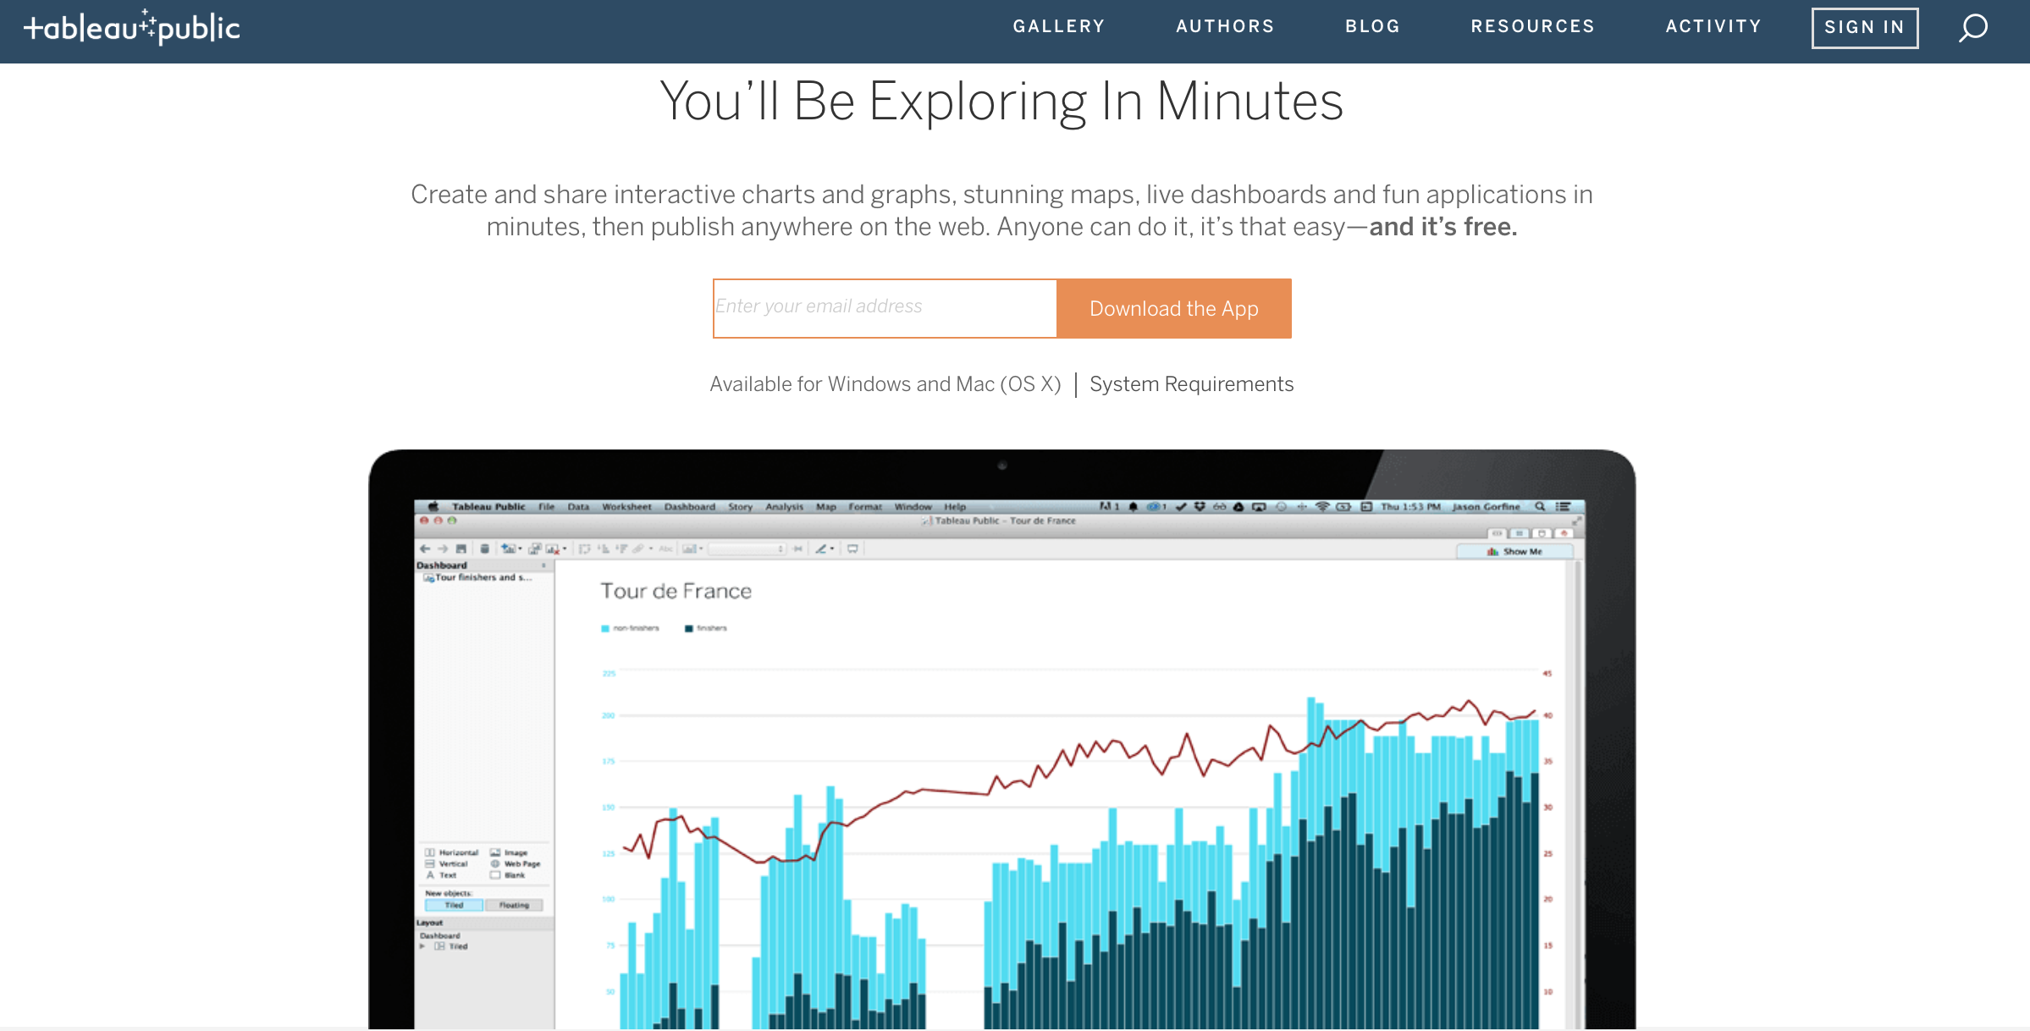
Downloading and Installing Tableau
Tableau For Students (1 year free trial)
https://www.tableau.com/academic/students
Tableau Public (Completely Free)
https://public.tableau.com/en-us/s/download

Slide 4
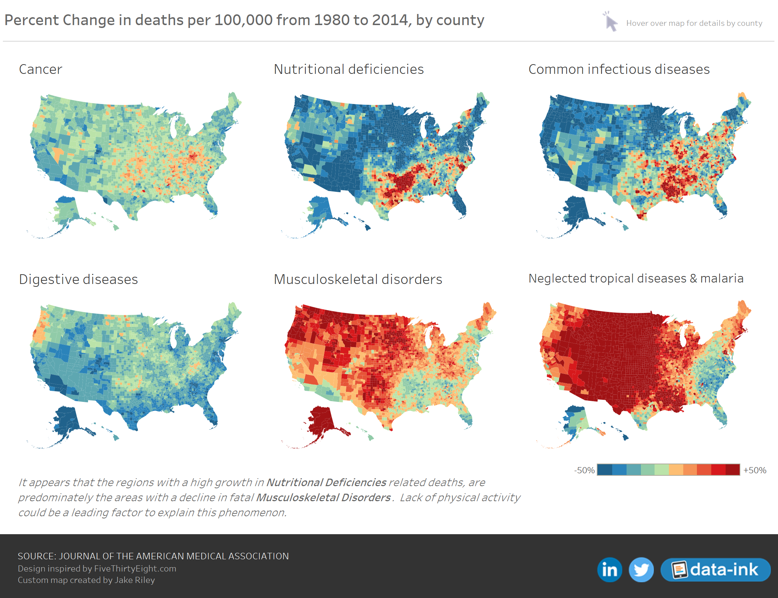

Tableau Public & Resources
Examples of Professional Work
https://public.tableau.com/en-us/s/gallery
Tableau Video Tutorials
https://www.tableau.com/learn/training

Slide 5
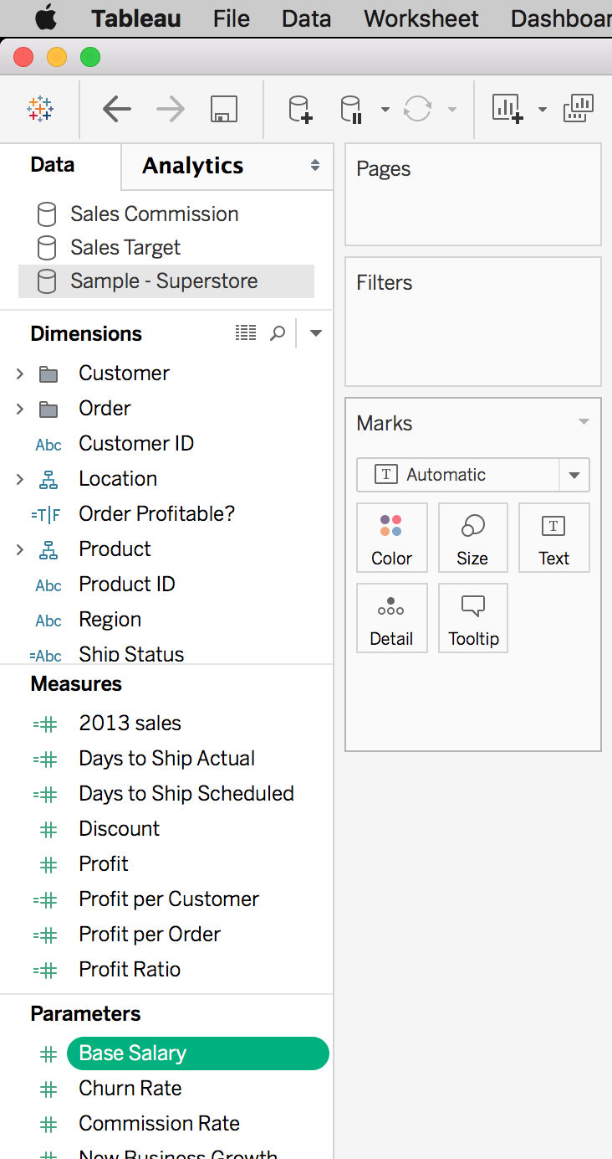
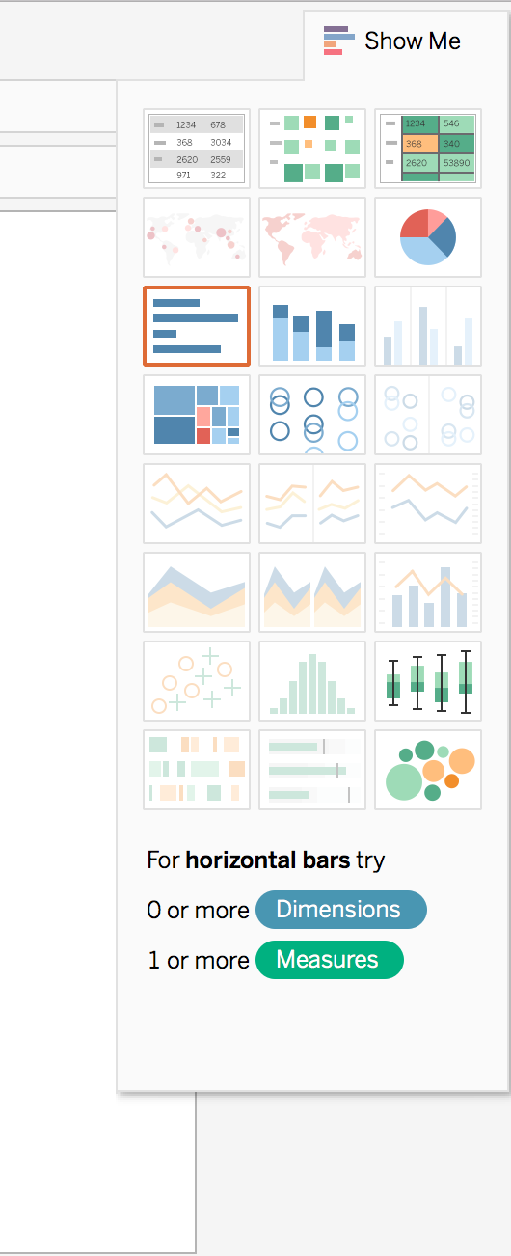
Understanding the Work Environment
Dimensions
Categorical Variables
Measures
Numerical Variables
Parameters
Threshold
Filter
Removables
Marks
Design choices
Charts
Data Visual Element
It will tell you what it needs

Slide 6
Understanding the Work Environment
Worksheet
One chart
Dashboard
More than one chart & images (drag multiple worksheets)
Story
Presentation format (drag multiple worksheets or dashboards)
Analysis
Models, measures, different calculated views
Format
Background design

Slide 7
Practice Makes Perfect
Makeover Monday:
http://www.makeovermonday.co.uk
Participate in making a new visual every week
Download Workbooks on Tableau Public:
https://public.tableau.com/en-us/s/gallery
Pick a professional visual > download > tableau workbook
Try deconstructing their work
Google and Youtube Videos:
https://www.youtube.com/watch?v=wRpBkl6-uhU&t=558s
https://vizpainter.com
There are many resources online!

